Slide 1


Solar Home Lighting
Final Presentation
Team 22 Jack Holdridge
Kyle Walcher
Matthew Greer
Adam Garcia
TA: Hailey Ward
Sponsor: Won Jang

Slide 2
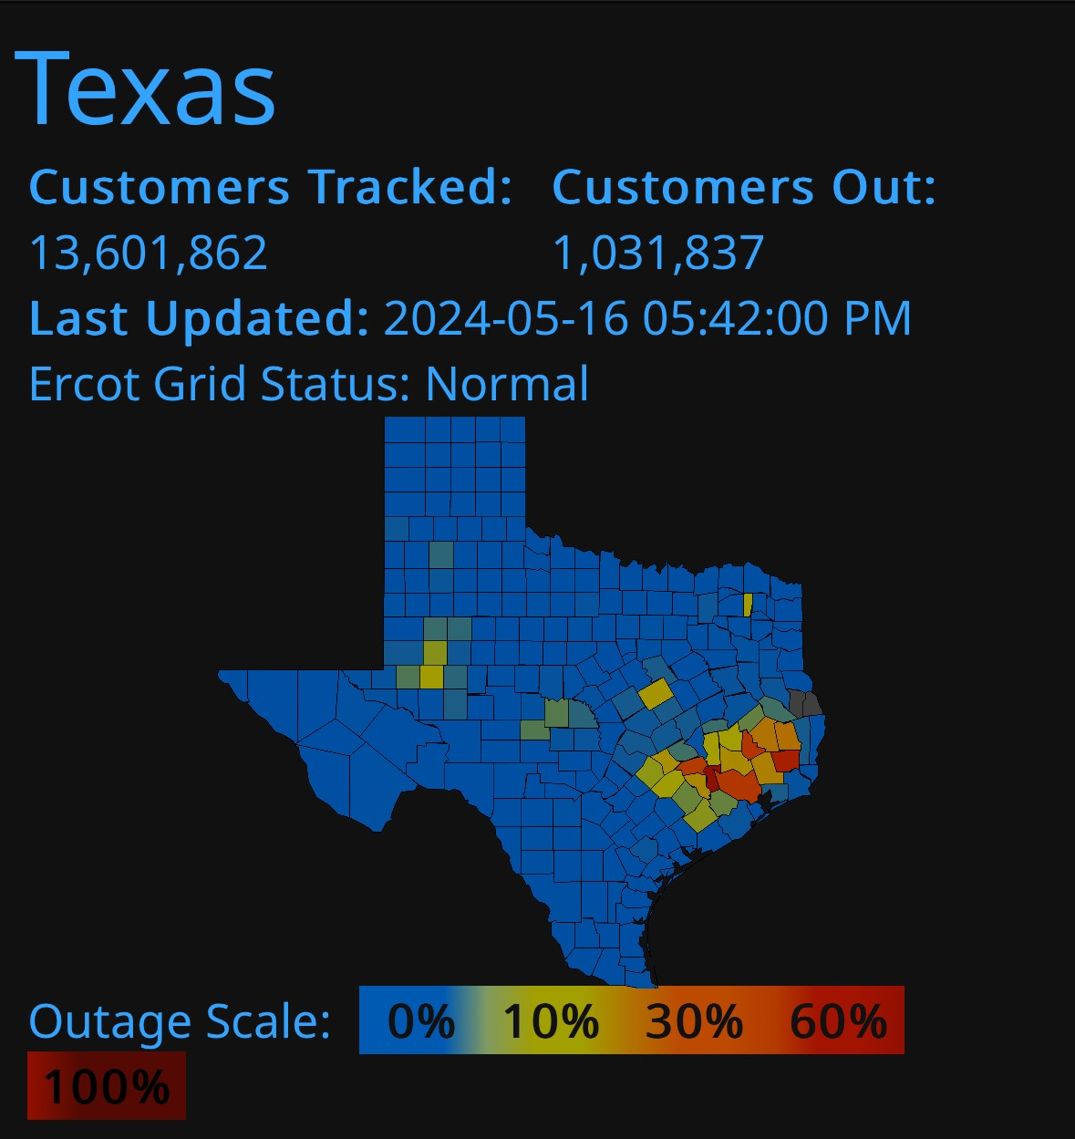
Problem Overview
Problem statement:
Residential homeowners lack a reliable, unified system that monitors basic security, and remains operations during power instability. Current solutions require separate devices, each with limited functionality and poor coordination. This leads to gaps in security, unreliable operation during outages, and poor user experience.
Our Solution:
Combine security, lighting control, and user interaction into one coordinated platform
Offer flexible controls, with both local and remote capabilities.
Ensures the home remains safely lit and monitored regardless of grid fluctuations.

Slide 3
System Overview
Kyle Walcher
Adam Garcia
Solar panel
MPPT charge controller
Android Application
(Kotlin/Java)
3.3v Buck Converteri
12v deep cycle battery
OpenAI/Python Flask Server
ESP32-WROVER
Jack Holdridge
Matthew Greer
12v Buck Boost DC converter
3.3v Buck Converter
MCU
Database
Touch screen HMI
ESP32
ESP32
Sensors
Relay board and LED Lights
Notes:
Cloud server and database

Slide 4
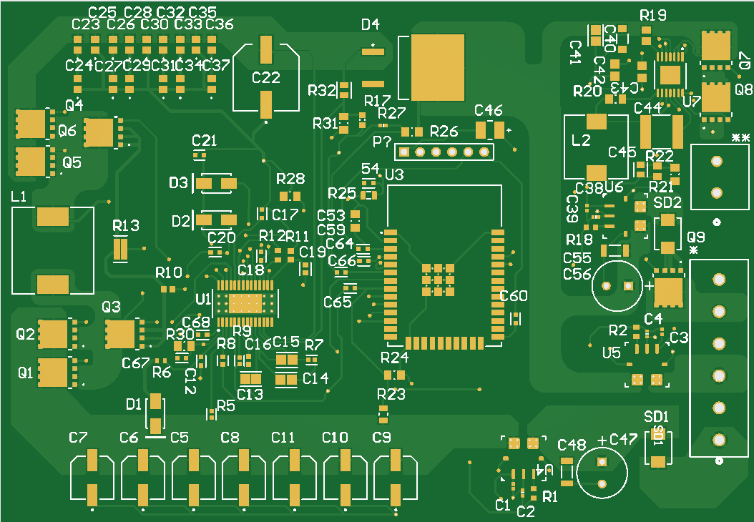
Charge Controller Subsystem Overview Adam Garcia
ECEN 403 Deliverables:
PCB Design
18.8V to 14.4V - 13.6V Buck Converter
Charge battery for different charging stages
14.4V - 12V to 3.3V Buck Converter
Input voltage for ESP32, ACS781LL Hall Current Sensors, & Buck enablers
ESP32 - MPPT
Perturb & Observe (P&O) via FB pin of 18.8V Buck Converter

Slide 5
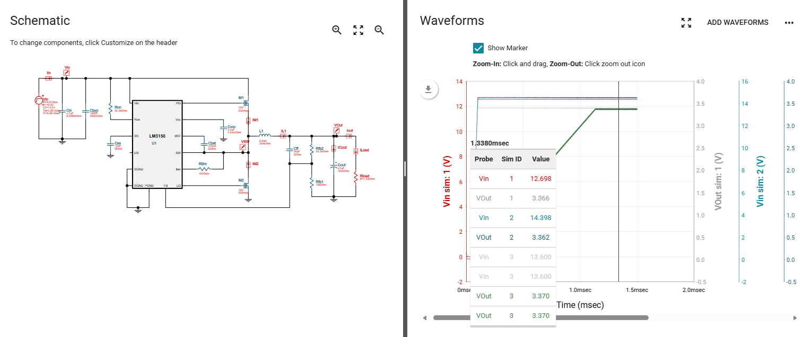
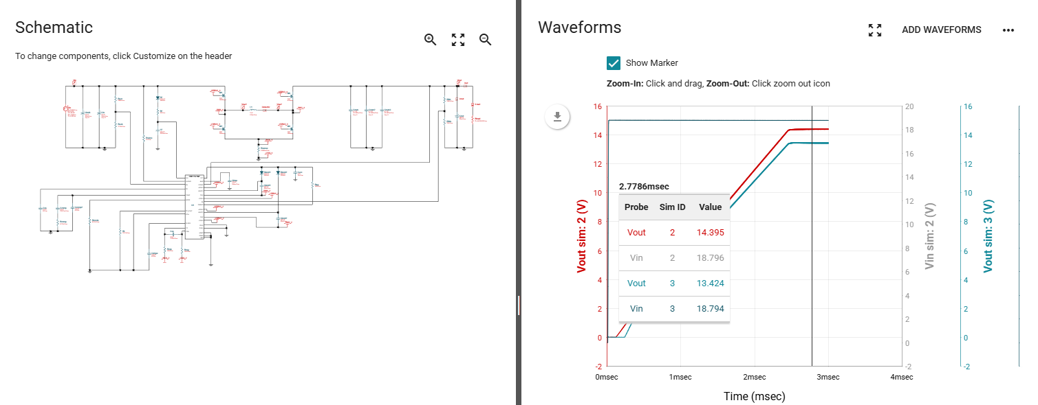
Charge Controller Subsystem Simulations Adam Garcia

Slide 6
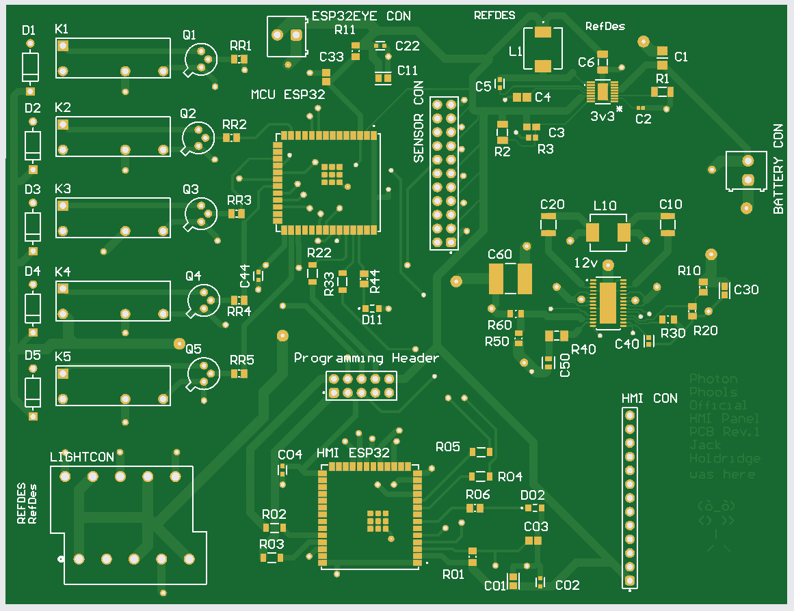
Physical Controls Subsystem Overview Jack Holdridge
ECEN 403 Deliverables:
Power Management Architecture
3.3V Buck Converter schematic and components.
12V Buck-Boost Converter schematic and components.
Power distribution network with fuse protection.
ESP32-S3 HMI and MCU
Sensor component selection and pin mapping.
HMI touchscreen user interface (menus, navigation, status).
Microcontroller power sequencing and boot mode layout.
System Integration
Full PCB layout, routing, and DRC verification.
Improved wifi antenna for Database communication.
Complete BOM finalized.

Slide 7
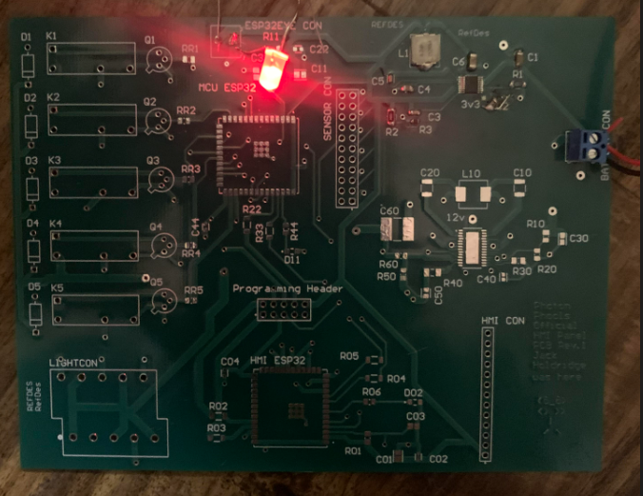
Physical Controls Testing
Jack Holdridge
Vin (V) | (3.3V) Vout Simulated | (3.3V) Vout Actual | (12V) Vout Simulated
10.8 | 3.3308 |  | 11.947
11 | 3.3306 |  | 11.950
12 | 3.3304 | 3.43 | 12.013
13 | 3.331 |  | 11.972
14 | 3.329 |  | 12.003
3.3V Buck Converter Assembly and Test
Assembled buck converter on PCB
Measured output voltage at 12v operating point.
Converter held regulation within expected tolerance.
HMI screen User Interface
Touchscreen inputs register correctly.
UI responds consistently to user interactions.
Passed power-cycle functionality test.
Path Forward
Assemble remaining PCB sections.
Preform DC converters Validation test.
Design and 3D print subsystem housing.

Slide 8
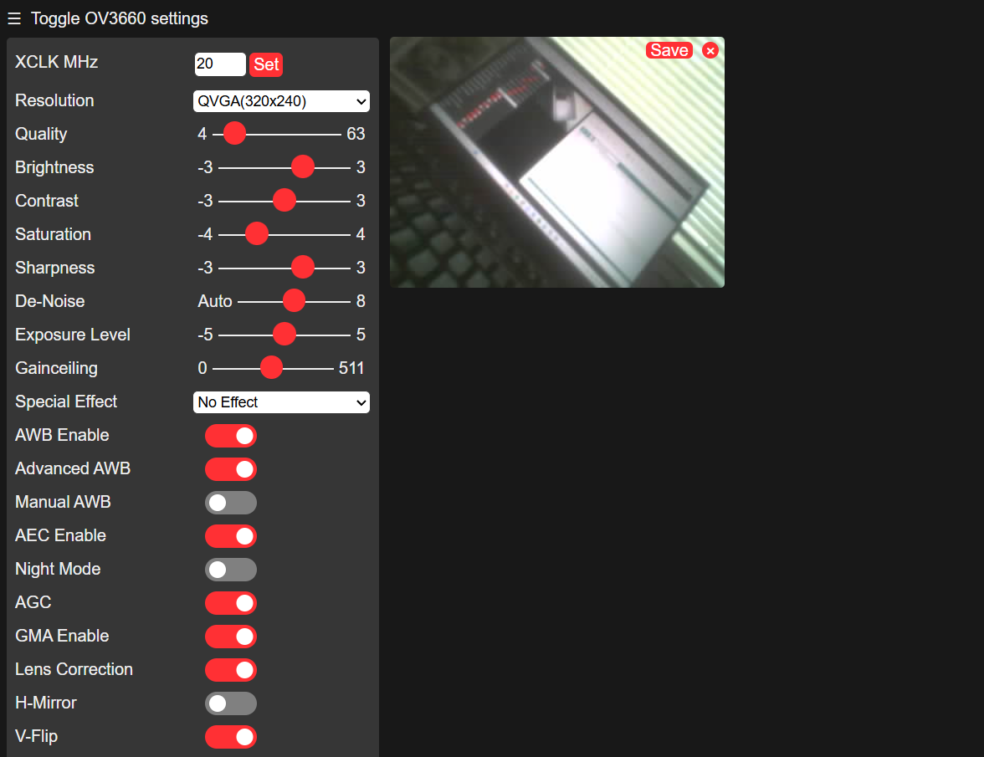
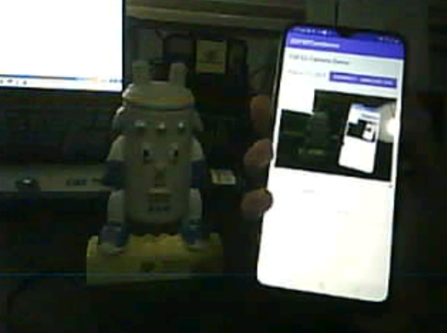
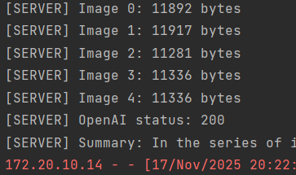
AI Security Camera Subsystem Overview Kyle walcher
ECEN 403 Deliverables:
ESP32 Wrover Module Camera
• Compiled and configured ESP32-CAM firmware using Arduino IDE
• Live MJPEG video successfully streamed over local WiFi
• Measured frame rate (avg 9 FPS) and optimized streaming parameters
• Verified stable connectivity with Android client
Android Application (Kotlin/Java)
• In-app snapshot capture stores images directly to device gallery
• AI Analysis Mode captures 5-frame burst and sends to backend for interpretation
• Push notification system alerts user with real-time AI summary
OpenAI API Backend (Python Flask)
• Local Python Flask server processes uploaded camera frames
• Successfully converts images → sends request to OpenAI
• Implements exponential backoff retry logic for rate limiting

Slide 9
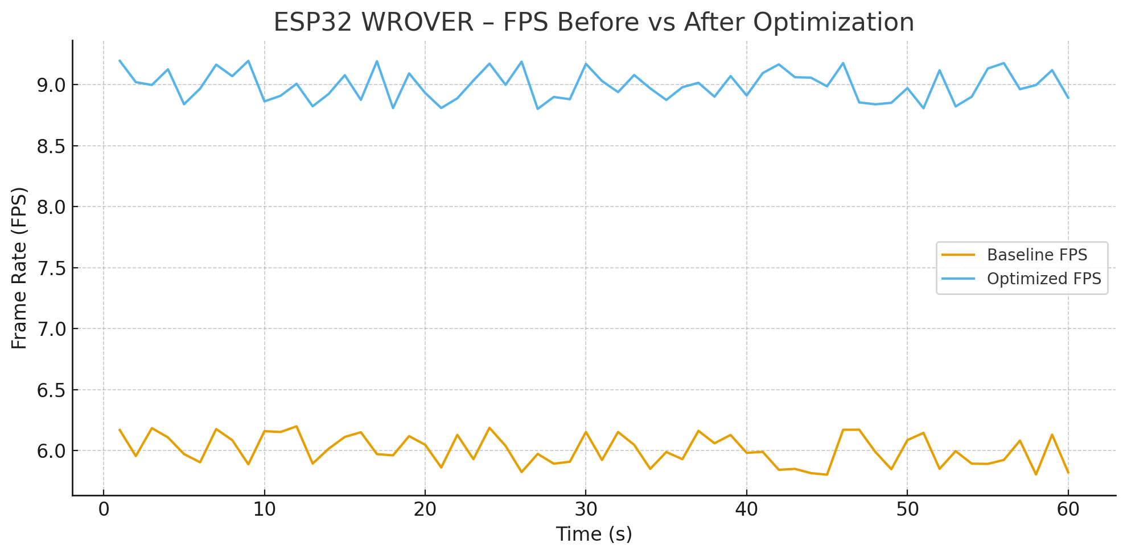
AI Security Camera Data
Stage | Time (ms) | Notes
Upload 5 images to Server | 80-120 ms | Local hotspot (fast LAN)
Server processing | 40-ms | Python Flask overhead
OpenAI API Analysis | 420-650 ms | Model Reasoning Time
Return to Push Notification | 30-70 ms | Android receives data and displays
Total Time | 0.6-1 s | From start to finish
Stabilized by using QVGA quality, disabling auto-exposure, and overclocking ESP32
Measured using Android and Flask server logs, then subtracting timestamps for each stage delay

Slide 10
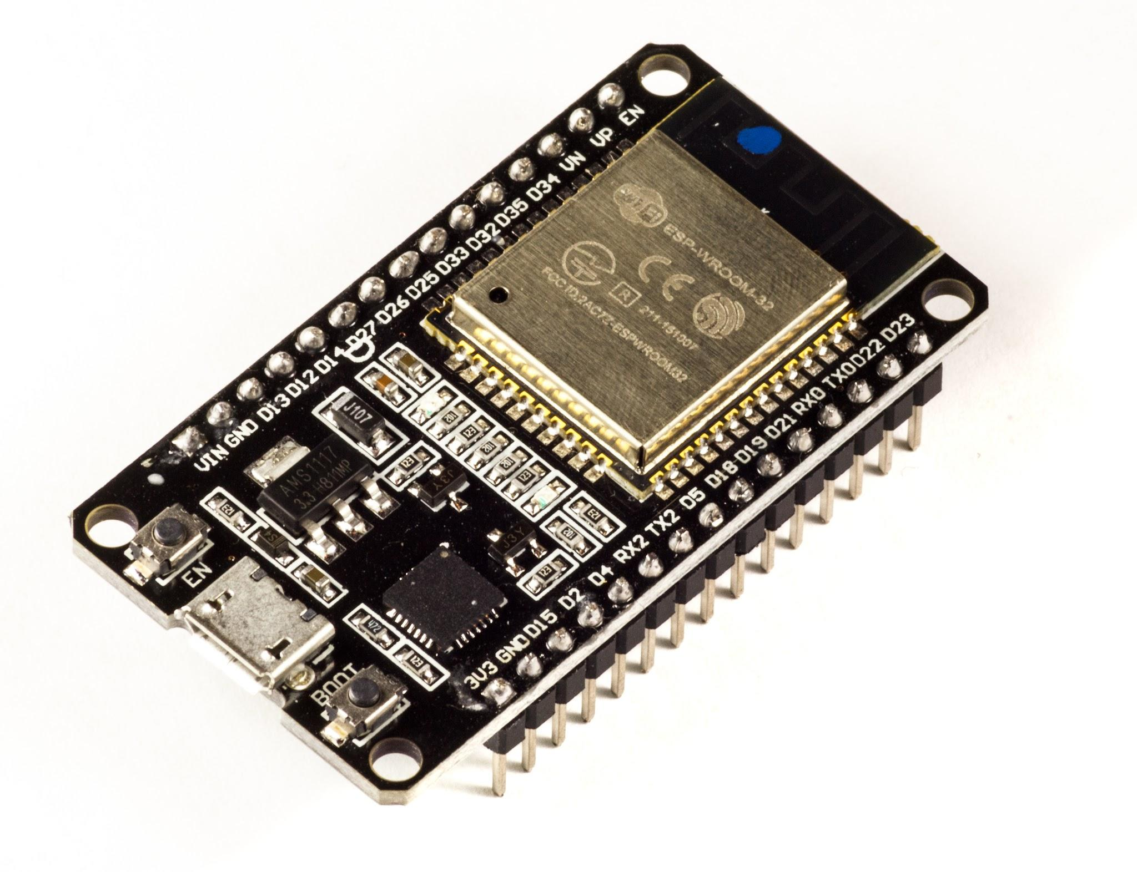
MCU Monitoring & Telemetry Overview
Firmware Development & System Control
Telemetry request/response protocol with charge controller implemented to generate summaries(avg/peak values, battery %, system activity).
Relay output logic completed for lighting control based on motion & daylight state..
Database & Communication
Established Wi-Fi data path to database (SQLite).
Designed JSON telemetry packet for historical logging and trend analysis.
Validated data uploads through 12-hour continuous test cycle.
Sensor Integration
Integrated PIR motion sensor with debounce filtering & false-trigger suppression.
Added LDR daylight sensing for automatic lighting and telemetry tagging.
Validated motion detection accuracy and coverage through controlled tests.

Slide 11
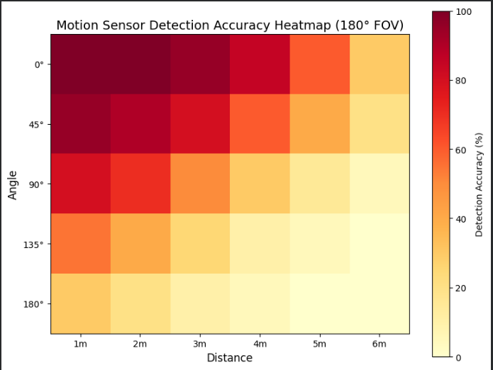
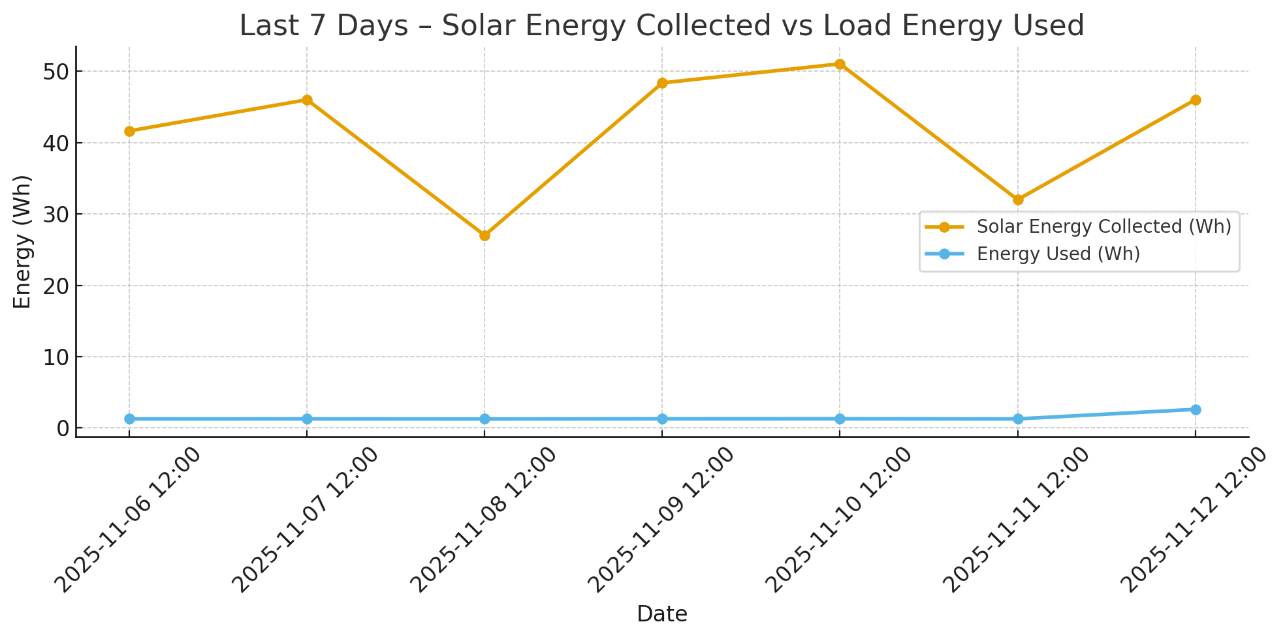
Subsystem Validation & Test Results
Test Case | Conditions | Expected Relay Outputs | Result
Daytime, No Motion | LDR = Day, PIR = 0 | Porch: OFF • Foyer: OFF • Security: OFF | Pass
Daytime, Motion | LDR = Day, PIR = 1 | Porch: OFF • Foyer: OFF • Security: OFF | Pass
Nighttime, No Motion | LDR = Night, PIR = 0 | Porch: ON • Foyer: OFF • Security: OFF | Pass
Nighttime, Motion | LDR = Night, PIR = 1 | Porch: ON • Foyer: OFF • Security: ON | Pass
Relay: Foyer Light | Relay_Foyer = ON | Foyer: ON | Pass
Relay: Porch Light | Relay Porch = ON | Porch: ON | Pass
Relay: Security Light | Relay Security = ON | Security: ON | Pass
Fail-Safe / Fault Condition | System Fault Flag = 1 | ALL Lights = OFF (Safety Mode) | Pass

Slide 12
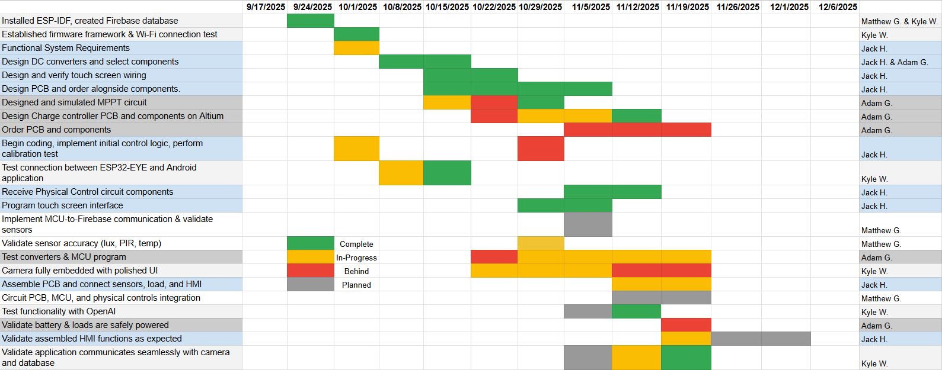
Execution Status

Slide 13
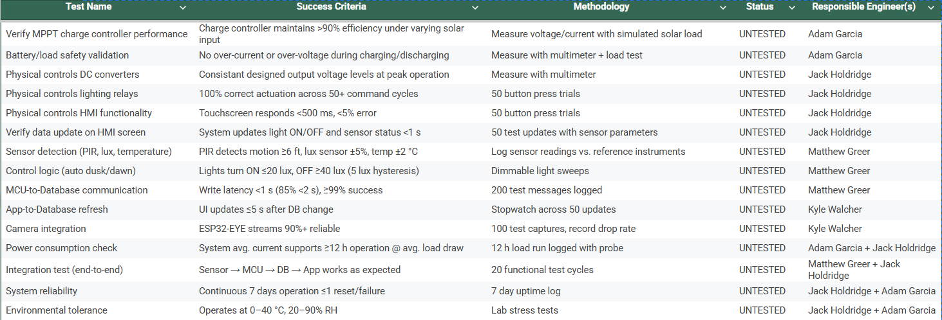
Validation Status

Slide 14
Remaining Tasks
MPPT Charge Controller
Order PCB and Components
Program ESP32
Physical Controls
Continue PCB Assembly.
Program HMI esp32 on PCB.
Validate PCB once completed.
Android Application and Camera
Adding user controls within application (OFF/ON, Different Users)
User Interface/QOL Improvements and accessibility
MCU, Sensors & Database
Transition MCU, and sensors from breadboard to perfboard for final hardware build
Validate all sensor & relay connections on perfboard to ensure stable operation
Finalize daily summary generation (SOC%, solar yield, load energy) and store in database
Complete full sub-system integration test (MCU + sensors + relays + charge controller + database)

Slide 15
Next Steps/Integration (ECEN 404)
Validate and test communication between subsystems.
Construct assembled product demo, with all subsystems.
Validate power is sufficient and stable for load.
Integrate communication between MCU and charge controller.
Switch Local Python Flask Server with final SQLite
Change Analyze Function from manual to MCU driven sensor activation

Slide 16
Solar Home Lighting 3:
Thank you for listening!
Questions?
Jack Holdridge, Kyle Walcher, Matthew Greer, and Adam Garcia
TA: Hailey Ward
Sponsor: Won Jang
‹#›

Slide 17
10.8-14.2 V Battery Feed
12v Buck Boost DC converter
3.3v Buck Converter
Touch screen HMI
ESP32
ESP32
Relay board and LED Lights

